Slide 1
Optimal Control on a Discrete Time Influenza Model
Paula A. Gonzalez-Parra¹ Leticia Velazquez^{1,2} Sunmi Lee³ Carlos Castillo-Chavez³
¹ Program in Computational Science, University of Texas at El Paso
² Department in Mathematical Sciences, University of Texas at El Paso
³ Mathematical & Computational Modeling Sciences Center, Arizona State University
Mathematics in Emerging Infectious Disease Management
Cuernavaca, Mexico.
January 13, 2011

Slide 2
Outline
Introduction
Epidemiological Model
Optimal Control Problem
Strategies and Policies
Numerical Results
Conclusions

Slide 3
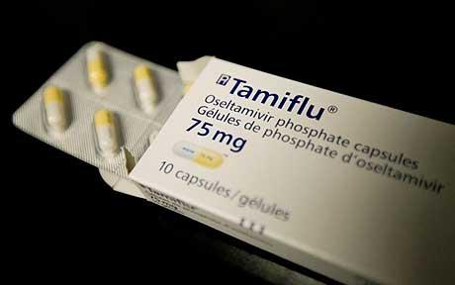
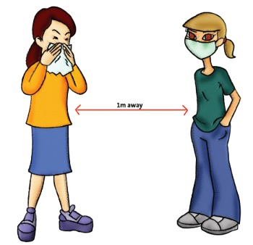
Introduction
Different continuous time approaches have been used to study single influenza outbreaks.
In particular, the identification of optimal control strategies that involve antiviral treatment and isolation have been investigated in the continuous case.
We introduce an optimal control problem in order to minimize the number of infected and dead individuals via the application of the most “cost-effective” policies, such as social distancing and antiviral treatment, using a discrete time epidemic framework.
http://i.telegraph.co.uk/telegraph/multimedia/archive/01
395/swine-flu-treatmen_1395505c.jpg
http://clovetwo.com/archives/2009/8/23
/healthnfitness/sf_05distance.jpg

Slide 4
Discrete SAITR Model
A
S
I
R
D
T
The model (1) is given by the system of difference equations:
(1)

Slide 5
Final Epidemic Size
In the absence of controls we get the final size relation
(2) where
The addition of controls replace (2) by the inequality
Result : If is a solution of (2) and satisfies the inequality (3) then

Slide 6
Optimal Control Problem
The goal is to minimize the number of infected and dead individuals with the judicious (cost effective) use of social distancing and antiviral treatment measured over a finite time interval [ 0, T_{f}]
The optimization problem is given by
The coefficients (B₀, B₁ , B₂, B₃ ) are predesigned weights that incorporate the costs of each of the terms.

Slide 7
Numerical Solution
The discrete Hamiltonian associated with problem (4) is given by:
Where and are the state and adjoint variables.
The adjoint equations are defined as
(5)
and the optimality conditions are:
(6)

Slide 8
Algorithm: (Forward-Backward method)
Step 1. The initial guess x , τ and condition y₀ is selected.
Step 2. Solve the state equations (1) forward in time.
Step 3. Solve the adjoint equations (5) backward in time with the transversality conditions,
Step 4. Solve the optimality condition (6) .
Step 5. Check convergence. If stop; else go to Step 2.

Slide 9
Numerical Results
We present the results of selected simulations generated by the optimal control problem with a given policy: Strategy 1 (Social distancing), 2 (Antiviral treatment) and 3 (Dual policies).
We compare the number of infected individuals generated by low R₀ (1.3 - 1.8) or high R₀ (2.4 - 3.2) with no controls or in the presence of single or dual optimal controls.
A sensitivity analysis is also carried out by studying the robustness of our simulations in relationship to the weight constants and the upper bounds of controls.

Slide 10
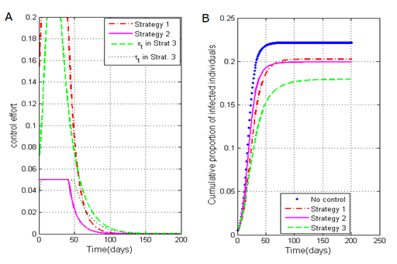
Implication of policies (R₀ = 2.4)
Figure (A): As expected, the optimal solution requires the implementation of the highest permitted values for each control.
Figure (B): Strategy 3 (dual policy) produces the highest reduction (~22% ) in the final epidemic size .
In conclusion: even when there is a maximum control implemented the reduction in the final epidemic size is appropriate to the situation.

Slide 11
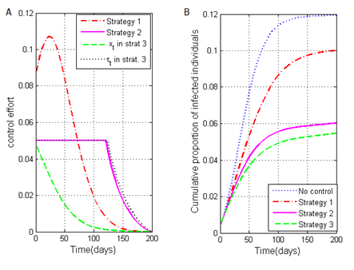
Implication of policies (R₀= 1.3)
In the case of social distancing, the optimal control solution does not require the application of the allowable maximum values.
For treatment, the optimal solution requires the implementation of the highest allowable values under each strategy.
Dual policy (Strategy 3) has a significant reduction of almost 57% in the final epidemic size.

Slide 12
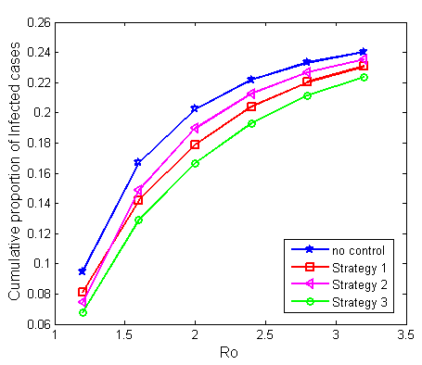
Comparison of final epidemic size vs. R₀
By fixing the weights B2 and B3 of each control function, the results show:
Strategy 3 (dual policy) yields the highest reduction of the final epidemic size (more than 31% for small values of R₀).
For single policies Strategy 1 (social distancing) has more impact in the reduction of the final epidemic size than Strategy 2 (treatment).

Slide 13
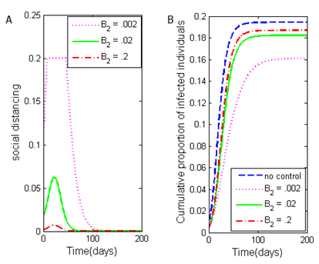
Social Distancing
The value of the weight constant B2 is varied. We observed that:
For small values of B2, the implementation of high values of social distancing is allowed and we obtain a high reduction in the final epidemic size (20%).
For large values of B2 the reduction in the final epidemic size is not significant (7.5%).

Slide 14
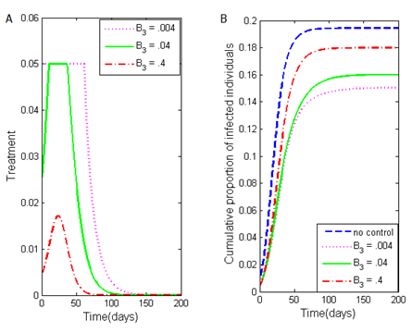
Antiviral Treatment
By increasing the cost on antiviral treatment (B3) the application of treatment is reduced and the cumulative proportion of infected cases increases.
In contrast (with moderate treatment cost) the implementation of high values of treatment is allowed and a substantial reduction on the final epidemic size is obtained (22%).

Slide 15
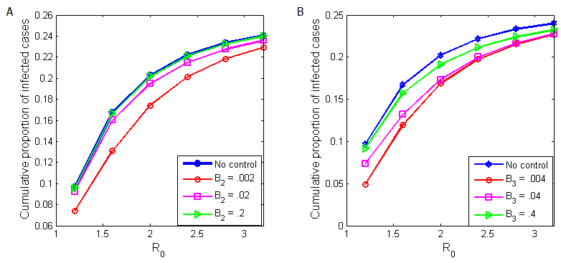
Final epidemic size vs. R0
Social distancing
Antiviral treatment
Figure (A): In the case the cost of social distancing is low, there is a significant reduction in the final epidemic size for every value of R0. However, when the cost is high, there is a very small reduction in the final epidemic size .
Figure (B): For treatment, when the cost is low (B3 = .004 and B3 = .04), there is not a considerable difference in the final epidemic size when R0 > 2.2.

Slide 16
Conclusions
The use of single and dual strategies (social distancing and antiviral treatment) result in the reduction on the cumulative number of infected individuals.
We compare the impact of relative costs on the effort carried out in the implementation of each single strategy (weight constants on controls) and the use of limited resources (control upper bounds).
Dual strategies have a stronger impact in terms of the reduction in the final epidemic size, but it is more cost-expensive.
Future work: We want to solve the problem using constrained optimization techniques. include a time delay in the application of policies and analysis of a multi city model.

Slide 17
Acknowledgments
Thanks to:
Program in Computational Science at the University of Texas at El Paso.
Marco Jose and organizing comittee.
Carlos Castillo Chavez and MTBI summer program
SPIDER Working Group at the National Institute for Mathematical and Biological Synthesis (NIMBioS).
Universidad Autonoma de Occidente, Cali - Colombia

Slide 18
References
Discrete epidemic models. F. Brauer, Z. Feng, and C. Castillo-Chavez. Math. Biosc. & Eng., 2010.
Optimal control for pandemic influenza: the role of limited antiviral treatment and isolation S. Lee, G. Chowell, and C. Castillo-Chavez, J.Theor. Biol., 2010.
Optimal control applied to a discrete influenza model. Paula A Gonzalez-Parra, Leticia Velazquez, Maria C. Villalobos, and Carlos Castillo-Chavez. Conference Proceedings Book of the XXXVI International Operation Research Applied to Health Services, Book ISBN 13: 9788856825954 edited by Franco Angeli Edition, June 2010.
A note on the use of optimal control on a discrete time model of influenza dynamics. Paula A Gonzalez-Parra, Sunmi Lee, Leticia Velazquez, and Carlos Castillo-Chavez. Mathematical Biosciences and Engineering, Vol. 8, No. 1, January 2011.
Questions?

